Slide 1

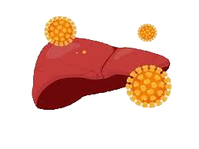
Hepatitis Data Analysis
Group number: 12
Group Members: Allen Sajju
Karpaga Varshini
Vinay Kumar

Slide 2
Background
Hepatitis is inflammation of the liver. Inflammation is swelling that happens when tissues of the body are injured or infected. It can damage your liver.
Objective
To find a correlation between the given inputs to mortality in Hepatitis cases.
The Path
Team followed a standard Machine Learning algorithm development process.

Slide 3
Data
The data around this population of customers had 20 attributes and 155 observations.
The output variable is Class and the rest are inputs.
The variables used to describe the demographics of the population e.g. AGE, SEX.
Medication - STEROID, ANTIVIRALS
Symptoms - FATIGUE, MALAISE and ANOREXIA
Physical Condition - LIVER BIG, LIVER FIRM, SPLEEN PALPABLE, SPIDERS, ASCITES, VARICES
Medical Report - BILIRUBIN, ALK PHOSPHATE, SGOT, ALBUMIN, PROTIME

Slide 4
Data Quality Check
There were 15 Categorical variables and 5 Continuous variables. There were 4-19% missing values observed in the continuous variables, which were replaced by the mean of the variables, and the outliers were either capped or floored.
Whereas the categorical variables were replaced by the mode of the variables.
1 variable(Prothrombin Test) was found to have more than 40% missing values and was not considered for the solution.

Slide 5
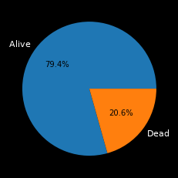
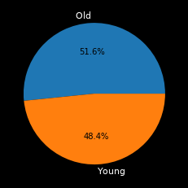
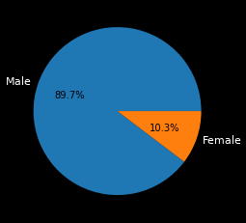
Demographic Ratio Pie Charts

Slide 6
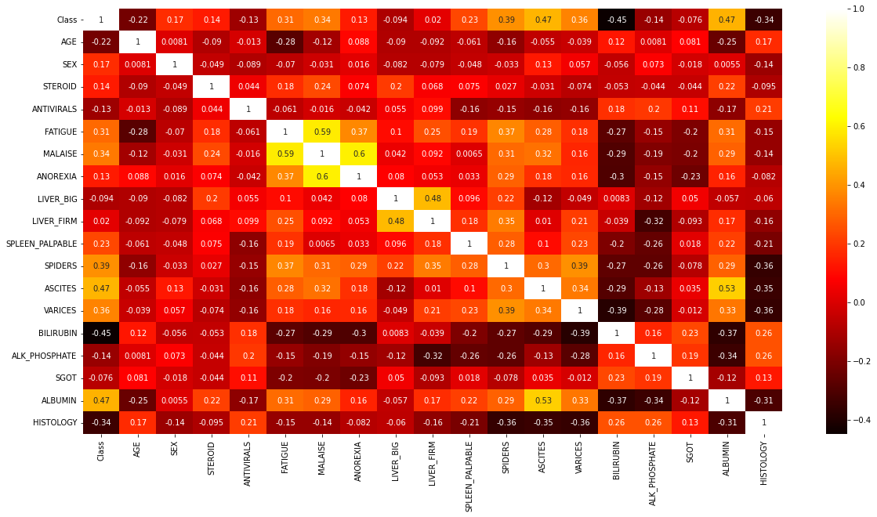
EDA Insights

Slide 7
Correlation
Lowest negative correlation with Class(“Dead”,”Alive”) is BILIRUBIN
Highest negative correlation with Class(“Dead”,”Alive”) is SGOT
Lowest positive correlation with Class(“Dead”,”Alive”) is LIVER_FIRM
Highest positive correlation with Class(“Dead”,”Alive”) is ASCITES
BILIRUBIN | -0.45
HISTOLOGY | -0.34
AGE | -0.22
ALK_PHOSPHATE | -0.14
ANTIVIRALS | -0.13
LIVER_BIG | -0.09
SGOT | -0.08
LIVER_FIRM | 0.02
ANOREXIA | 0.13
STEROID | 0.14
SEX | 0.17
SPLEEN_PALPABLE | 0.23
FATIGUE | 0.31
MALAISE | 0.34
VARICES | 0.36
SPIDERS | 0.39
ALBUMIN | 0.47
ASCITES | 0.47

Slide 8
Algorithms
Depending on the response : Categorical
Given how the data is very binary in nature we have chosen the Categorical Response and gone with KNeighborsClassifier after trying other models such as Support Vector Classifier and Logistic Regression with Train and Test ratio of 7:3.
And since the data is very imbalanced ,we have balanced it out by Synthetic Minority Over-sampling Technique (SMOTE)

Slide 9
Model Statistics
index | accuracy | f1 | recall | type | balance
0 | 0.84 | 0.36 | 0.37 | Logistic Regression | No
1 | 0.83 | 0.83 | 0.83 | Logistic Regression | Yes
2 | 0.75 | 0.18 | 0.17 | KNN | No
3 | 0.87 | 0.88 | 0.92 | KNN | Yes
4 | 0.84 | 0.46 | 0.52 | SVC | No
5 | 0.85 | 0.85 | 0.86 | SVC | Yes

Slide 10
Summary
Given the size of the data and low feature count,It would be difficult to make a firm conclusion.
But Antivirals seem to be having an adverse effect on the Patients in comparison to Steroids and leading to more deaths(non substantial),
Abdominal swelling is also something they should keep an eye on .
But changing the treatment methods on the basis of such a small sample would be ill advised.

Slide 11
Recommendations
Some recommendations for patients are
Lowering alcohol consumption
Practice personal hygiene
Eat proper meals
Make sure to get your vaccines on time

Slide 12
Sources
Dataset - https://archive.ics.uci.edu/ml/datasets/Hepatitis
Github Links
Allen Sajju-
https://github.com/Al-3/Hepatitis-Capstone-Project/blob/main/Capstone_Project(Hepatitis).ipynb

Slide 13


Slide 14
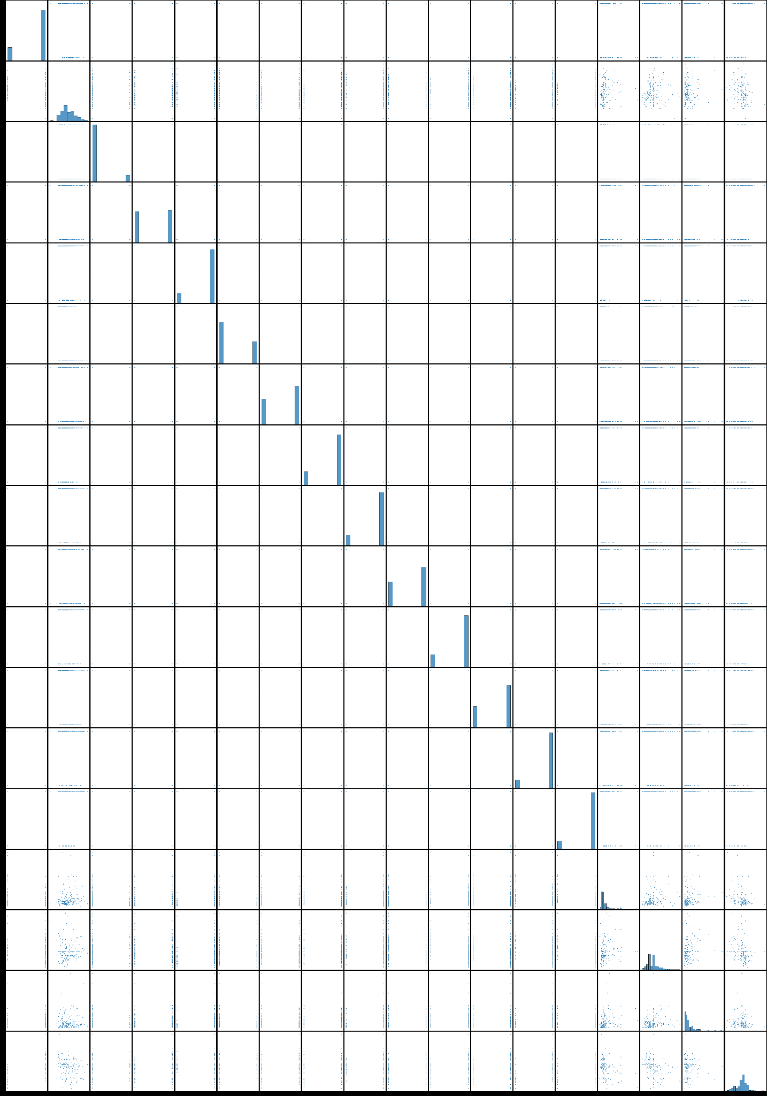
Appendix 1
PairPlots

Slide 15
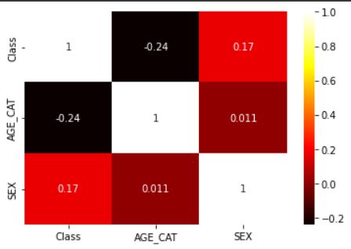
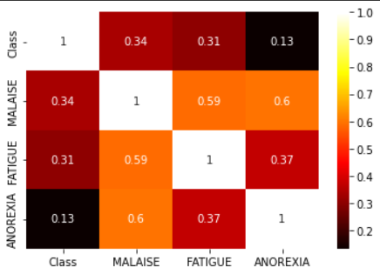
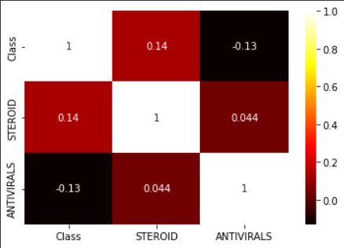
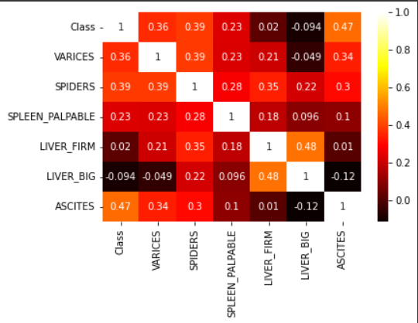
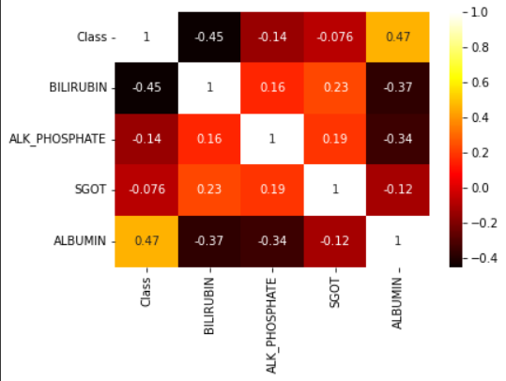
Appendix 2

